Slide 1
Behavior Driven Development
Test First Development in .NET

Slide 2
In This Module
The evolution of TDD
Using context
Writing specifications

Slide 3
Behavior Driven Development
Why?

Slide 4
What’s Wrong With Unit Tests?
The focus on testing
What We Care About
Behavior
Experience
Stories
Desirements
What We Focus On
Test Suites
Units
Verification Tests
Implementations
A major difference is vocabulary. – Dave Astels

Slide 5
What is BDD?
It has the same mechanics as TDD
We follow the rhythmic chant of red, green, refactor
We work in tiny increments
We design
BDD focuses on behavior
Don’t focus on implementation details
Don’t organize tests around abstractions (no test fixture per class)
BDD focuses on context
What is the setting for this play?
BDD focuses on specifications
Avoid the mindset of writing verification tests
BDD focuses on communication
Change your vocabulary – communicate outside of development

Slide 6


What’s A Context?
Contexts are natural and recognizable uses of a class or subsystem or web page, etc. – Scott Bellware

Slide 7
Contexts in Code
It’s not a unit
Unit tests often centered around a class
A class should have a single responsibility
However, many classes serve varying contexts
How many different contexts are in the following code?
public class MovieController : Controller
{
public ActionResult Index() { … }
public ActionResult Details(int id) { … }
public ActionResult Create() { … }
…
}

Slide 8
Specifications
Specify the behavior you want to experience in a given context
Stop thinking of tests
Think about what the software should do
Don’t write specifications for developers
Think about the expectations of a customer
Think about executable specifications or acceptance criteria
… the language you use shapes how you think … and if you want to change how you think it can help to first change your language. – Dave Astels

Slide 9
BDD
How?

Slide 10
Communication
Users and user stories give you raw building material
Stories capture motivation, language, and expectations
BDD turns raw material into executable specifications
Story
As a member of the movie review’s site
I want to review a movie
So I can influence the movie’s rating
Dialog
Given a new movie
When adding a new review with a rating of 1
Then the average movie rating should be 1
And the movie should have 1 total review
Scenarios

Slide 11
A Simple Start
[TestFixture]
public class When_adding_first_review_to_movie {
[SetUp]
public void Setup() {
_movie = new Movie();
var review = new Review {Rating = 1};
_movie.AddReview(review);
}
[Test]
public void should_have_one_review() {
Assert.That(_movie.TotalReviews == 1);
}
[Test]
public void should_have_an_average_rating_of_one() {
Assert.That(_movie.AverageRating == 1);
}
private Movie _movie;
}

Slide 12

Observations
Organize test classes around a specific context
Name the class by what it focuses on
Small and focused
Describe the experience using specifications
Simple, short, and focused
Test Fixtures
Presentation
Concerns
Context
Context
Context
Model
View
Controller
Context
Context

Slide 13

Language Observations
Who will find these results useful?
Developers?
Testers?
Customers?

Slide 14
Next Steps
Base classes for explicit context vocabulary
public class ContextSpecification
{
[SetUp]
public void Setup()
{
Context();
}
protected virtual void Context()
{
}
}
public class New_movie_context :
ContextSpecification
{
protected override void Context()
{
_movie = new Movie();
...
}
protected Movie _movie;
}

Slide 15
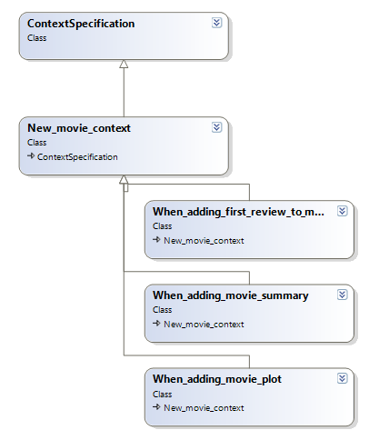
Sharing Context
Keep tests DRY
Can chain contexts
But favor readability

Slide 16
Moving Forward
Remember BDD demands a shift in vocabulary
Therefore a shift in mindset
Unit testing frameworks use a testing vocabulary
Perhaps there is something better?

Slide 17
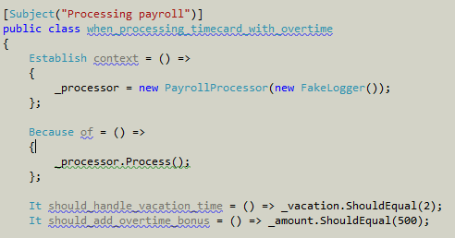

MSpec

Slide 18
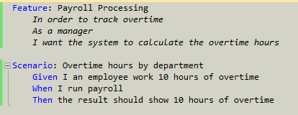
SpecFlow

Slide 19
Conclusions
BDD does not change your mechanics
Incremental design
Red, green, refactor
BDD changes your vocabulary
Specification, not verification
BDD is about:
Behavior
Context
Specifications
Communication to a wider audience

